Slide 1

USWDS Monthly Call
May 2024

Slide 2

Hi!
Thanks for being here!

Slide 3
Agenda
Featured sites
Product updates
Accessibility in civic spaces
Q&A

Slide 4
Featured sites

Slide 5
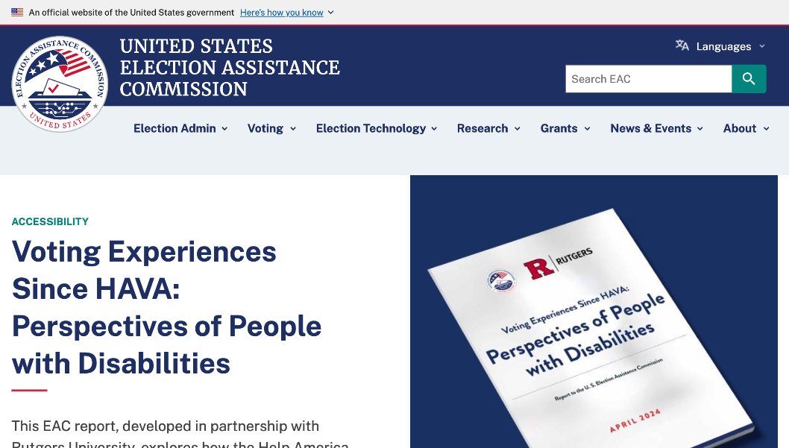
United States Election Assistance Commission
eac.gov
Notes:
TK

Slide 6
Great work!

Slide 7
Product updates

Slide 8
USWDS 3.8.1
Coming next week

Slide 9
August Monthly Call
Community Choice!

Slide 10
Accessibility test update
Character Count, Prose, Tag

Slide 11
Global Accessibility Awareness Day

Slide 12
Amy Cole
she/her
Accessibility Specialist USWDS Contractor

Slide 13
Alex Hull
she/her
Accessibility Specialist USWDS Contractor

Slide 14
Whitney Quesenbery
she/they
Co-Founder & Director
Center for Civic Design

Slide 15
Creating accessible civic spaces
Building accessibility into voting systems

Slide 16
Focus on the impact on people
(not a vague severity scale)
Type of problem | What it means
Slammed doors (critical) | Barriers that stop someone from using an app or feature successfully – or at all
Frustrating (serious) | Problems that slow someone down, or force them into work-arounds
Annoying (moderate) | Things that make the experience less pleasant (maybe even enough to leave)
Noisy (minor) | Minor issues that damage credibility but are unlikely to cause problems

Slide 17
Designing for delight begins with a balance of small pleasures and consideration
Top-left:
Low expectations
Good experience
Pleasant surprise
Top-right:
High expectations
Good experience
Expectations met
from Bad experience toGood experience
Bottom-left:
Low expectations
Bad experience
Expectations met
Bottom-right:
High expectations
Bad experience
Uh-Oh
Y axis: What we get
from Low expectations to High expectations
X-axis: What we expect

Slide 18
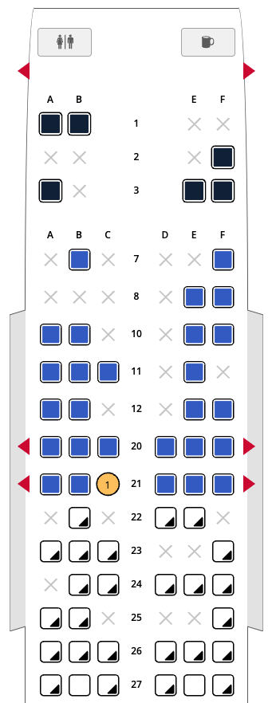
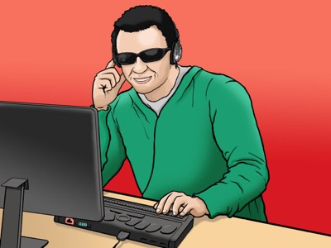
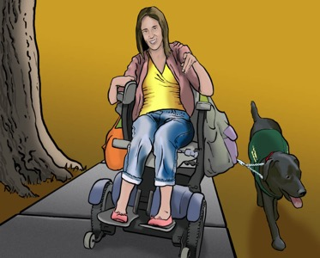
Why might this information be delightful?
Jacob
Emily

Slide 19
Definition of disability
Disability: The outcome of the interaction between a person... and the environmental and attitudinal barriers they may face.
International Classification of Functioning (ICF),
World Health Organization

Slide 20
Usability
The effectiveness, efficiency and satisfaction with which a specified set of users can achieve a specified set of tasks in a particular environment.
Accessibility
The usability of a product, service, environment or facility by people with the widest range of capabilities.
Definitions of usability and accessibility
Part 11: Usability: Definitions and concepts
Part 20: An ergonomic approach to accessibility
ISO 9241 - The ergonomics of human-system interaction

Slide 21
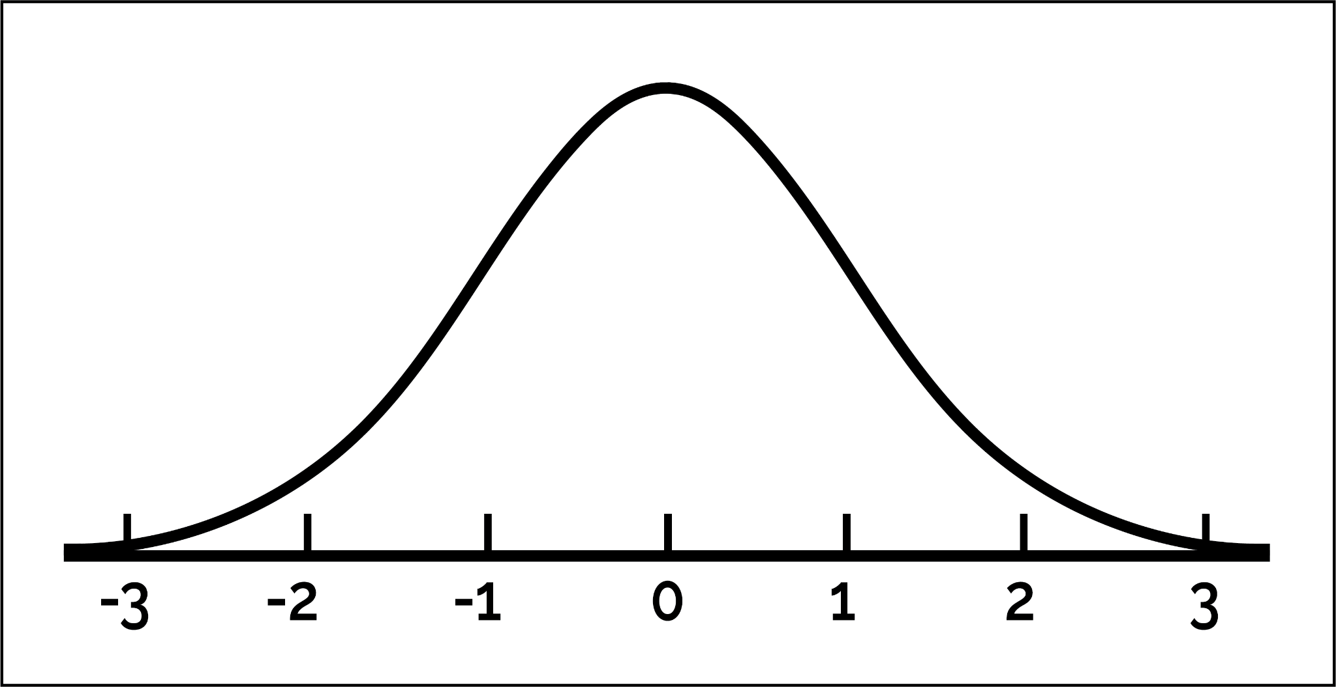
Pushing the boundaries so no one is left out
Usability
Accessibility
Accommodation
Assistance

Slide 22
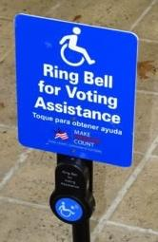
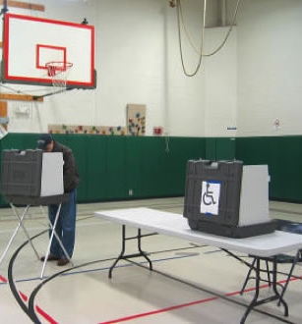
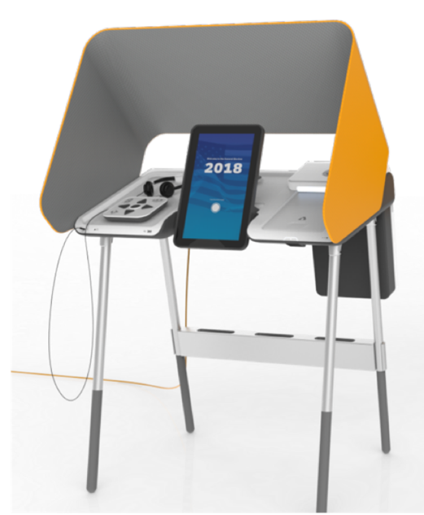
From accommodation to universal design
Accommodation
Accessibility
Universal design

Slide 23
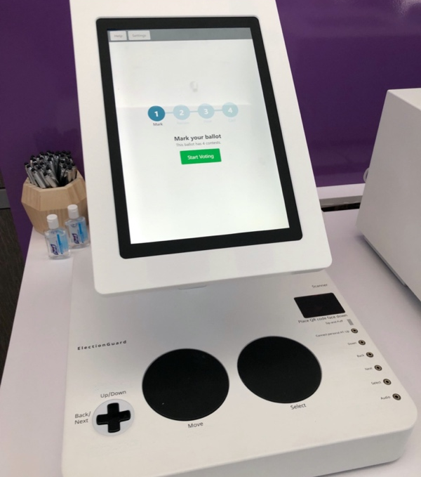
A universal controller for accessible voting is also delightful

Slide 24
VVSG 2.0 requirement
Within any method of voting, all display formats including enhanced visual and audio and all interaction modes including tactile and limited dexterity must have the same functionality as the visual format and touch mode including voting, verification, and casting.
Principle 5 – Equivalent and consistent voter access
5.1-A Voting methods and interaction mode

Slide 25
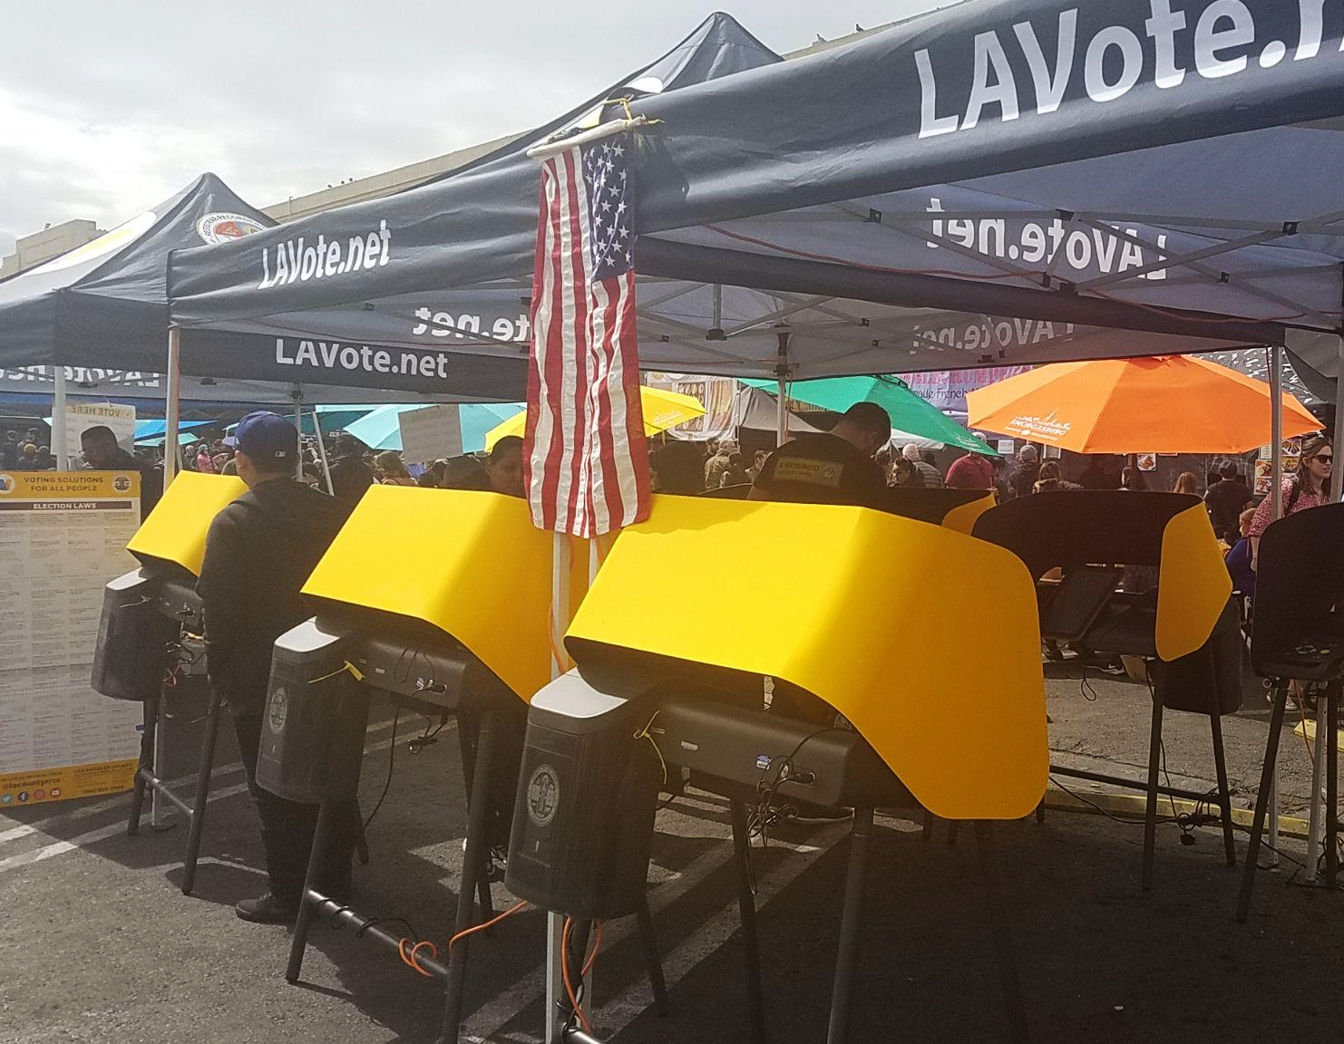
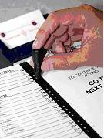
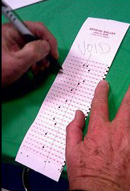
In 2020, Los Angeles County went from one of the most backward voting systems to the most advanced.

Slide 26
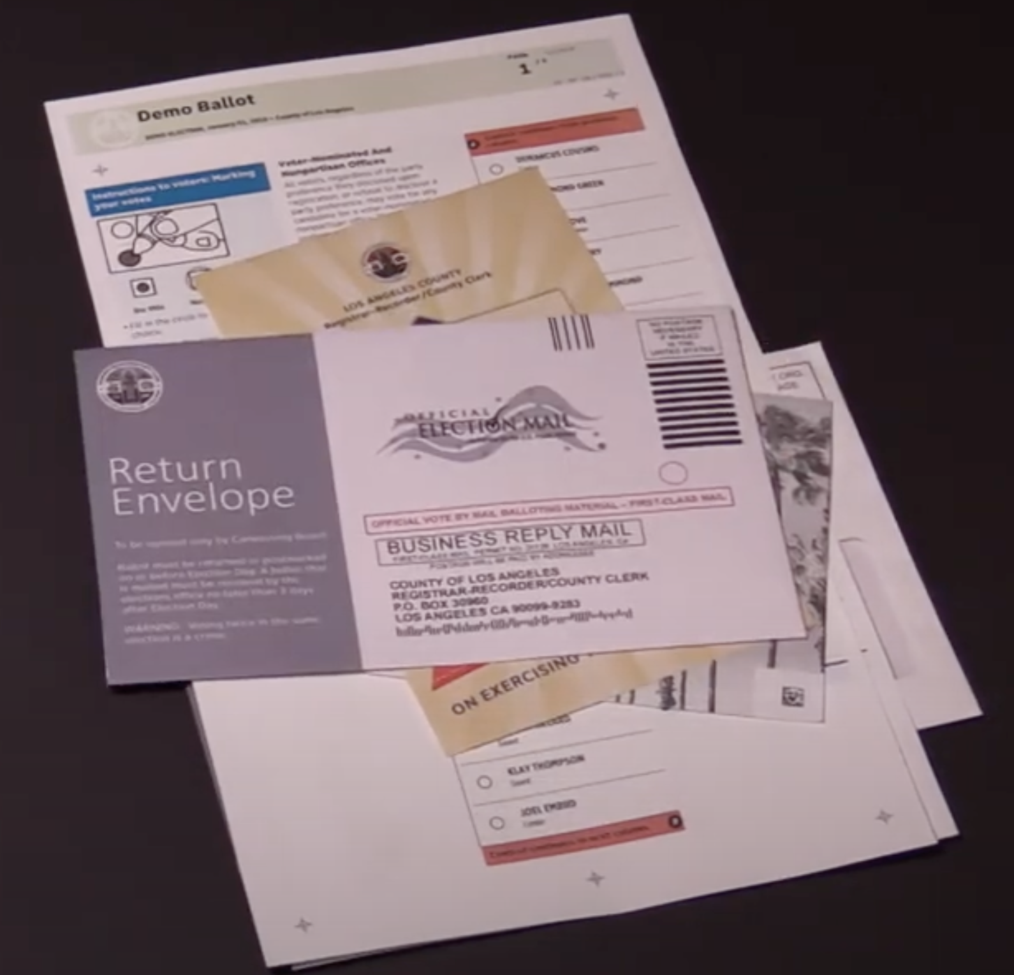
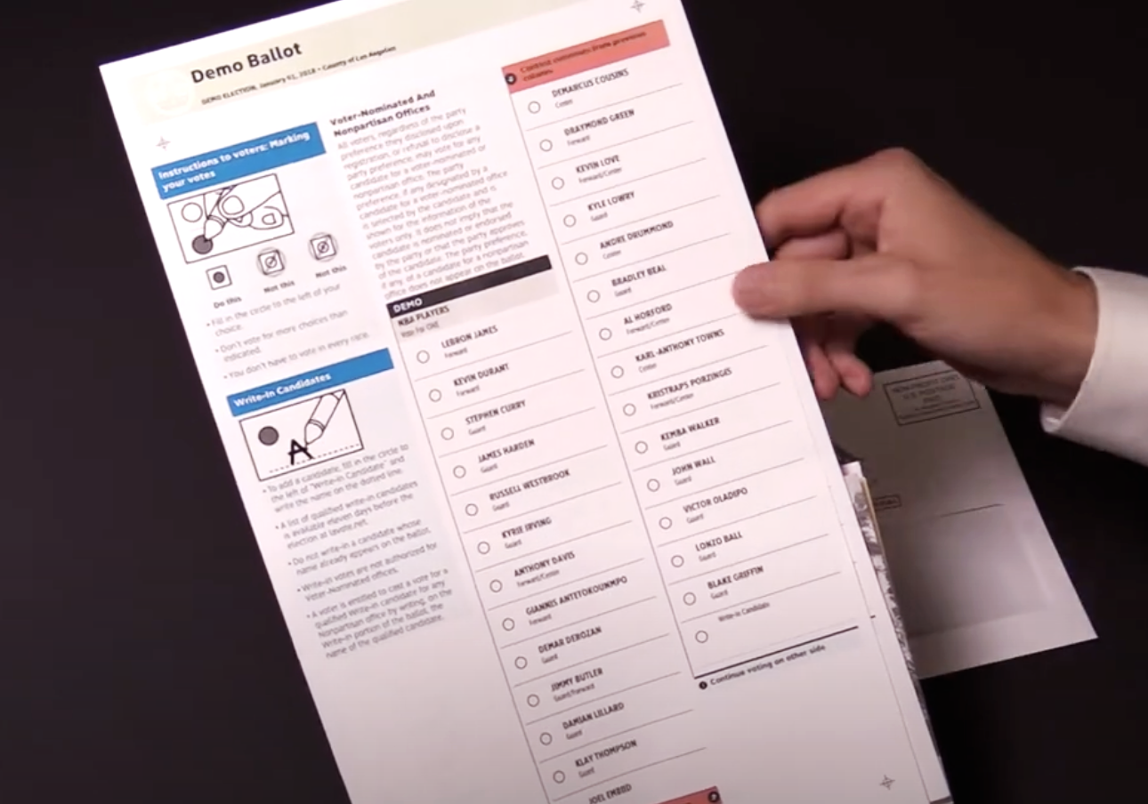
Vote-by-mail ballots launched in 2018

Slide 27
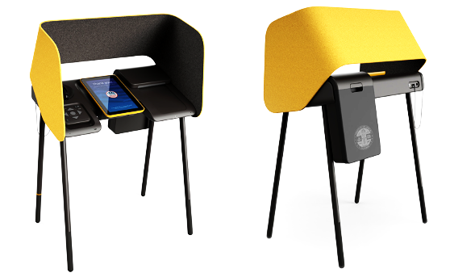
VSAP (Voting System for All People) is designed for universal use, and for 2 weeks of operation in vote centers.

Slide 28
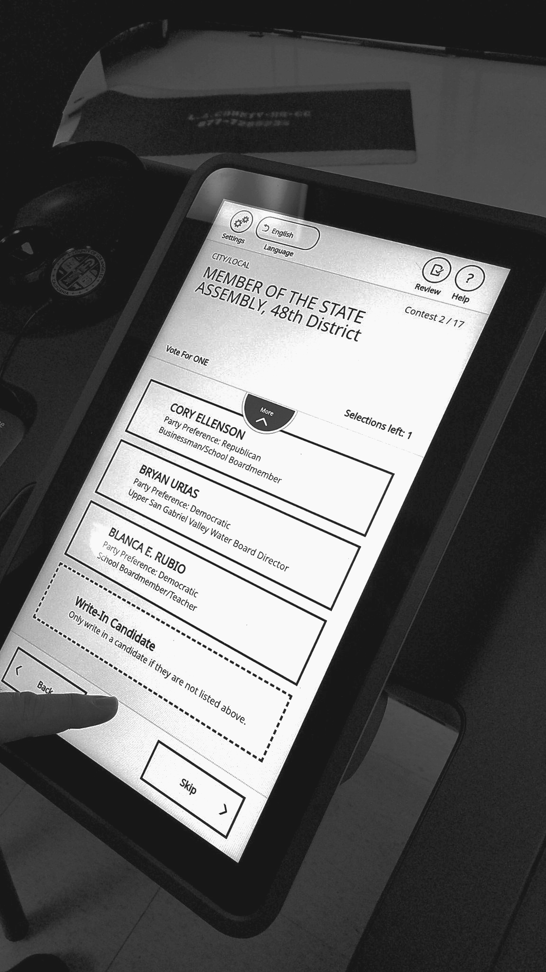
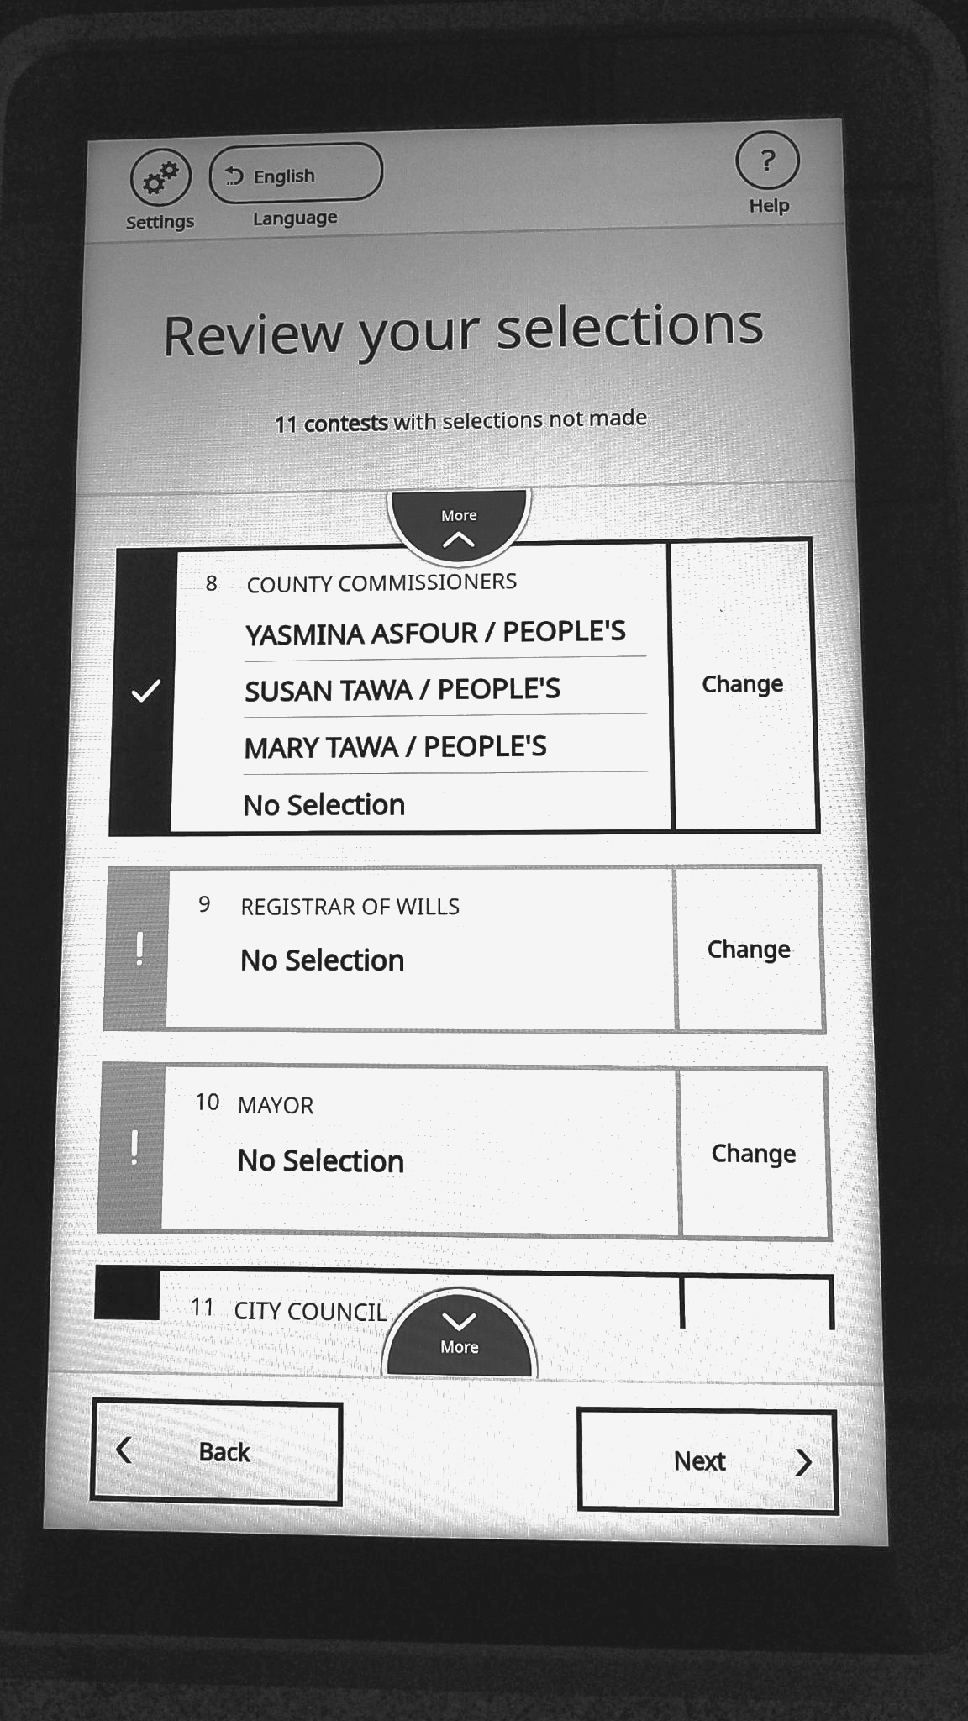
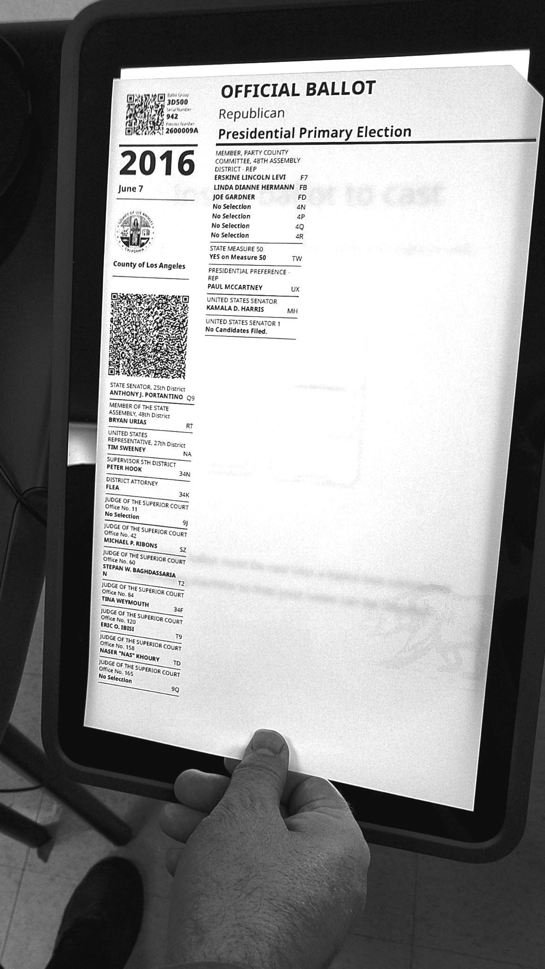
Ballot marking systems: Mark, review, print, verify, cast

Slide 29
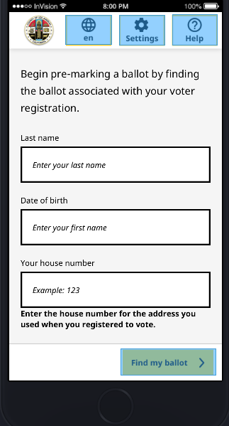
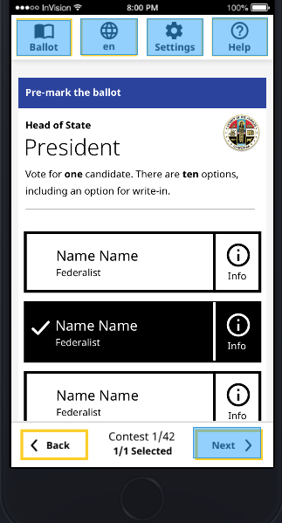
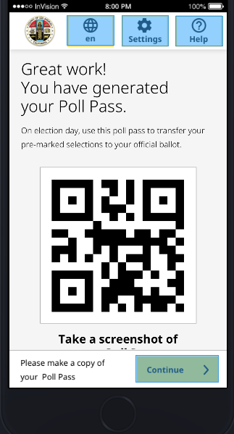
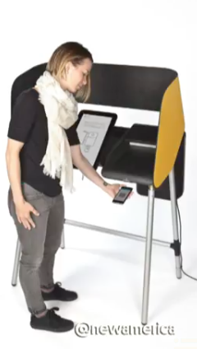
The Poll Pass: Mark your selections anywhere, vote in person.

Slide 30
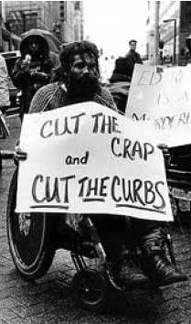
Closing thoughts
Start with intent. Define guiding principles towards goals for everyone, and consider how disabilities affect the path to success.
Get ahead of the work with preliminary research and keep it going with testing as you design and develop.
Involve stakeholders through the process for both input and transparency.
The work never ends.
Thank you!
Photo: mtstcil.org

Slide 31
Q&A
Notes:
DW

Slide 32
Next month
June: A first look at Web Components
#uswds-public
github.com/uswds
designsystem.digital.gov
Notes:
DW

